Slide 1
Predicting conditions that upset the separation of water and oil in petroleum production

Slide 2
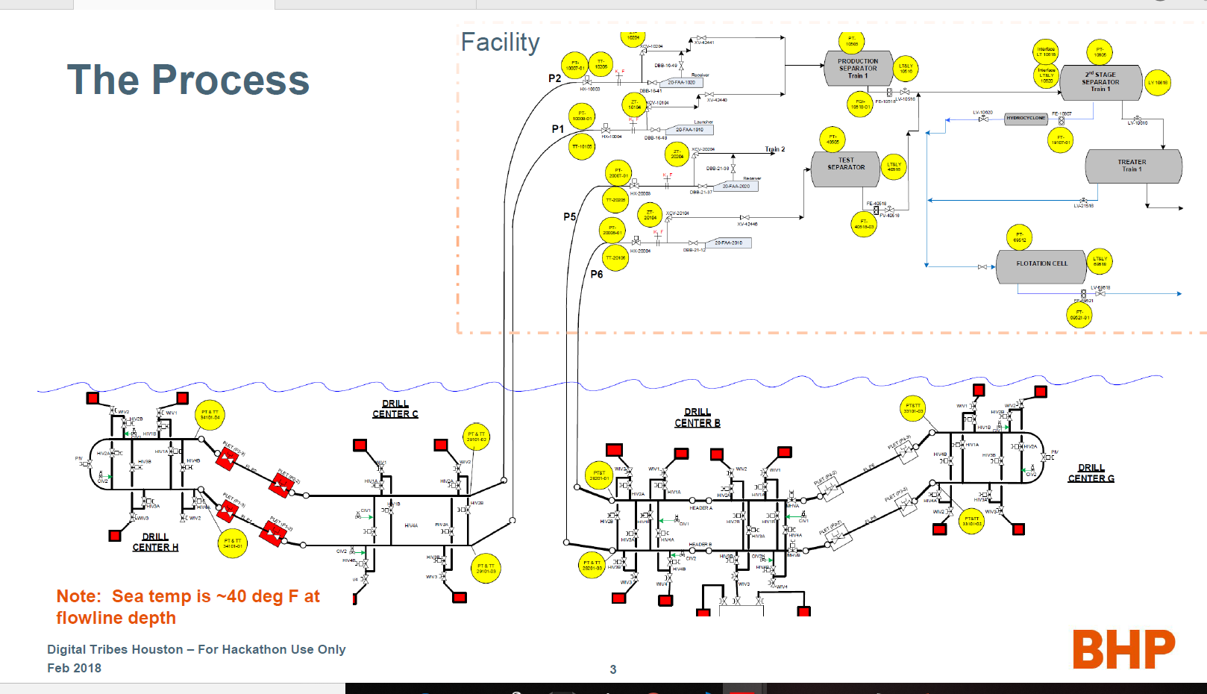

Slide 3
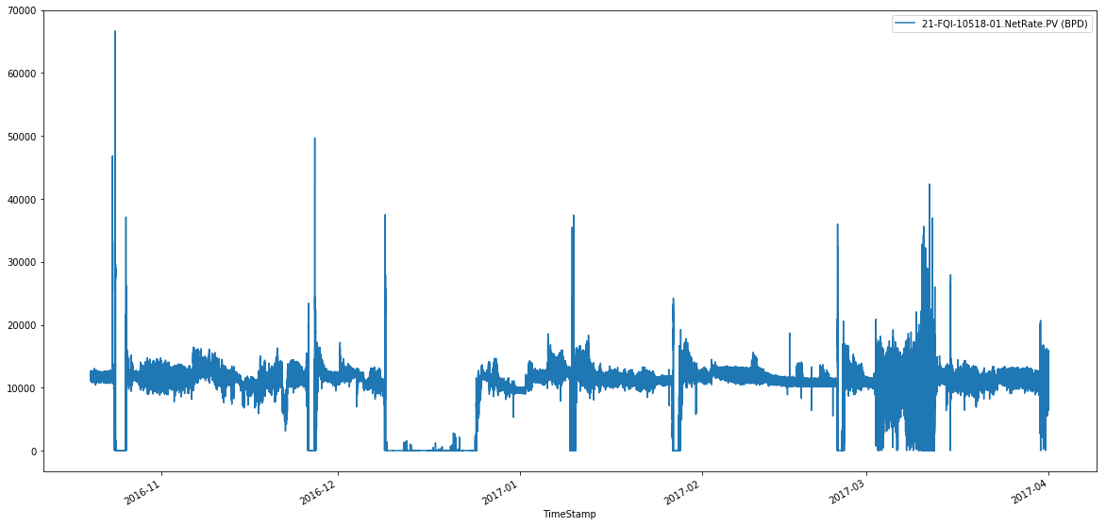
Facility output
Flat lines show zero output

Slide 4
Requirements
Correlation between flowline parameters and facility parameters for predicting upsets
Prediction of upset from flowline parameters(good to have)

Slide 5
Requirements
Correlation between flowline parameters and facility parameters for predicting upsets
Prediction of upset from flowline parameters(good to have)

Slide 6
Exploratory data analysis
Two files containing sensor(temperature, pressure, flow rate, etc) readings in every 30 seconds interval
164 days
6 upset days
Flowline data has 41 features
Facility data has 51 features

Slide 7
Challenges:
Requires domain knowledge to understand dataset
To come up with upset definition
Dataset not labelled
Skewed data
Time lag between the sensor readings at facility and flowline. Liquid from drill centres reach facility in between 1 to 6 hours

Slide 8
Our approach
Time series analysis and anomaly detection

Slide 9
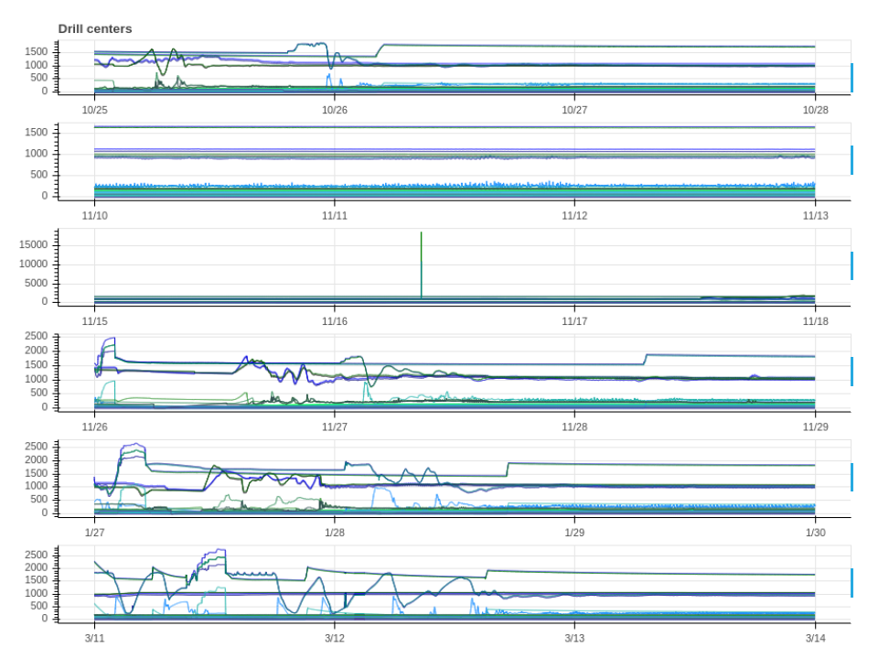
Flowline parameters on upset days

Slide 10
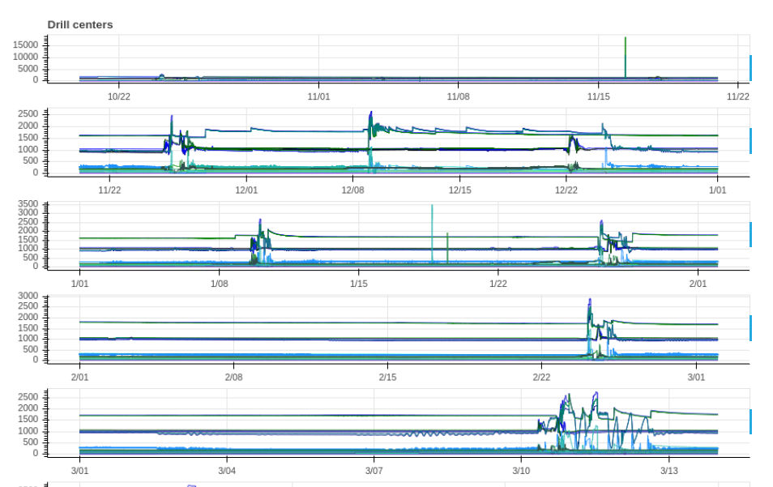
Flowline parameters for entire dataset

Slide 11
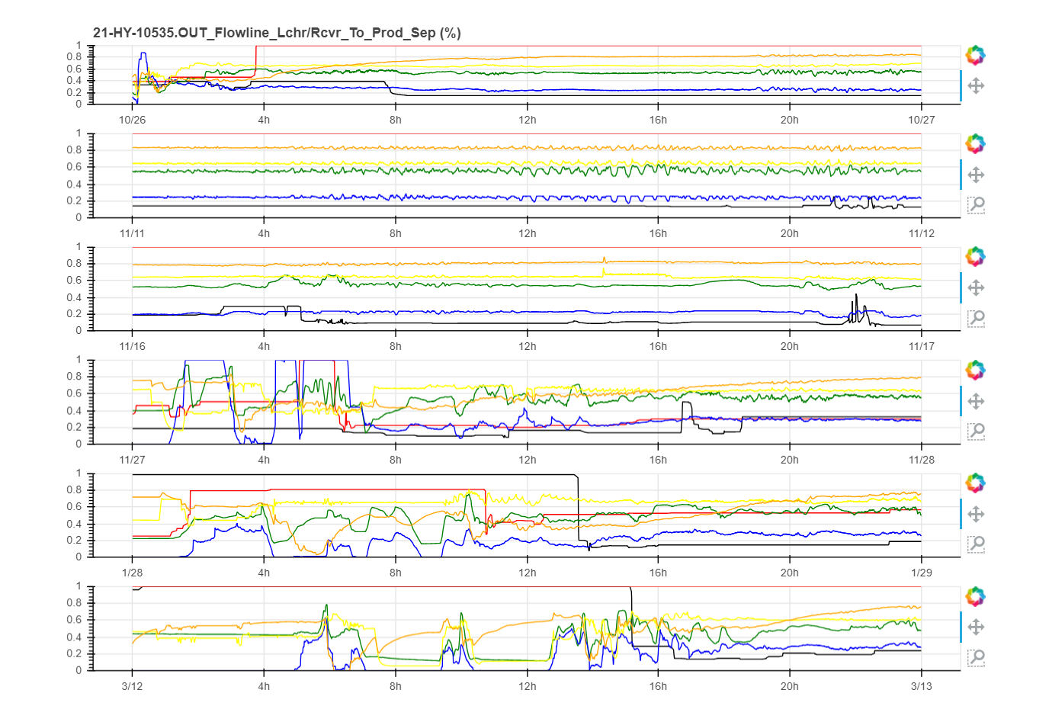
Facility parameters on upset days
Notes:
21-HY-10535.OUT_Flowline_Lchr/Rcvr_To_Prod_Sep (%)",
"21-HY-40534.OUT_Test_Separator_Inlet (%)",
"21-LT-10515.PV_Prod_Sep_Oil_Interface_Level (%)“
,"21-LY-10516.OUT_Prod_Sep_Oil_Out_To_2nd_Stg_Sep (%)“
,"21-PT-10505.PV_Production_Separator (PSIG)",
"21-TT-10508.PV_Prod_Sep_Gas_Out_To_Flash_Clr (Deg.F)"

Slide 12
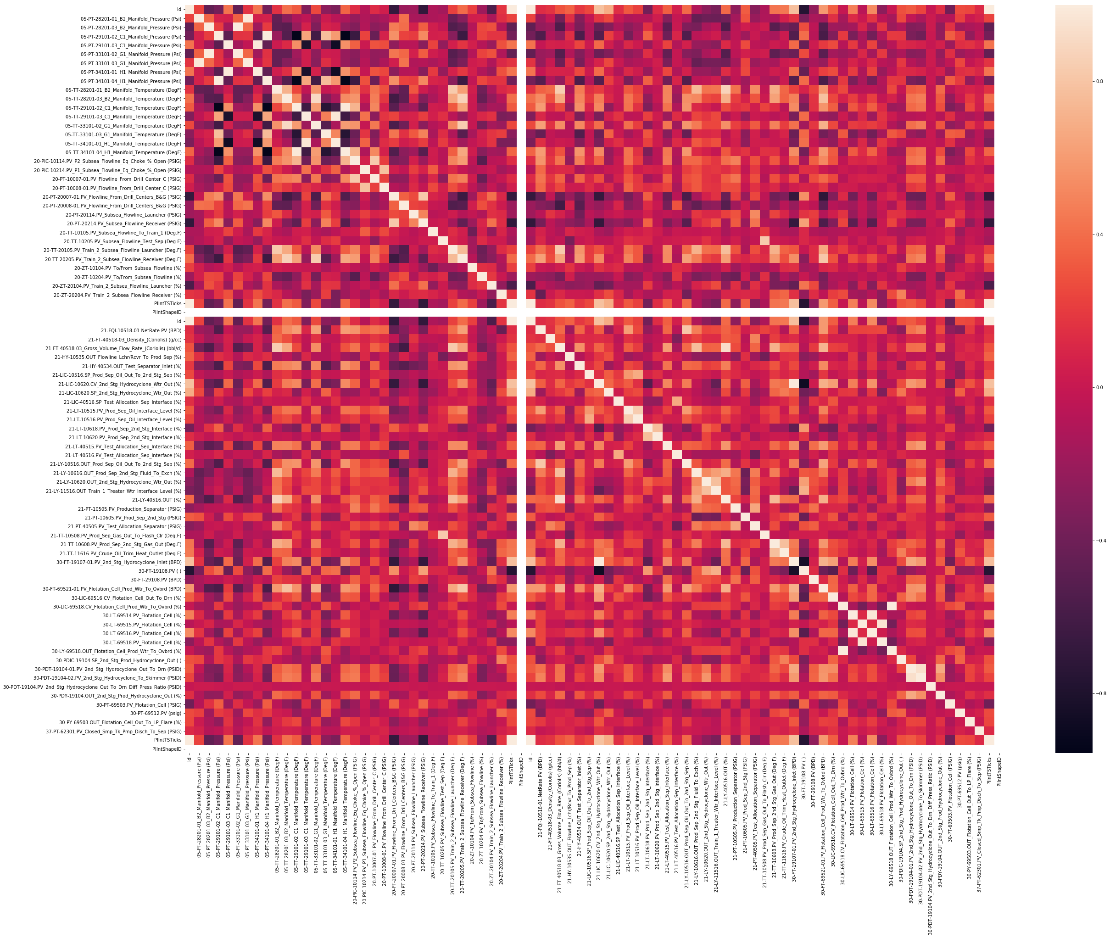
Correlation heatmap

Slide 13
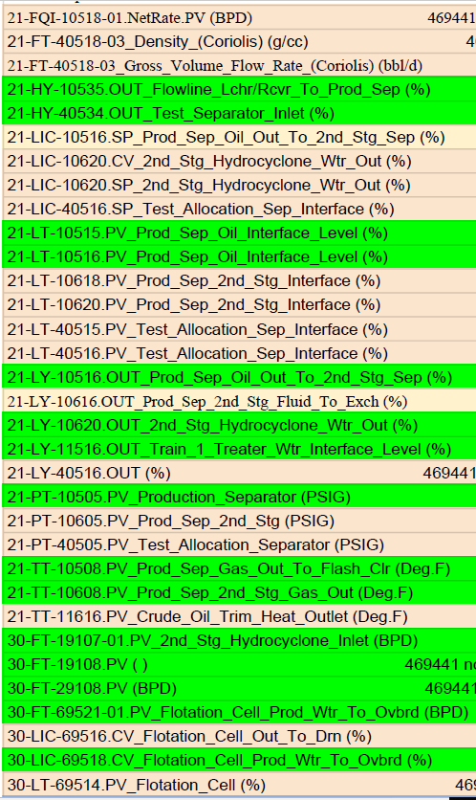
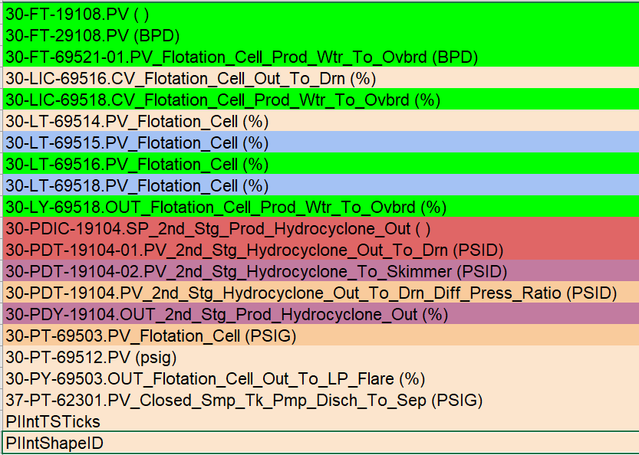
Facility parameter analysis
Affects upset
No Upset
Other similar colour columns behave in a same pattern

Slide 14
Our findings
Multiple features in flowline contribute to upset
An upset can be identified by certain facility features
An upset is strongly correlated with value failures at the flowline.

Slide 15
What next?
Use a clustering algorithm like K-means to label data
Predict the upset before it happens by taking advantage of time delay between flowline and facility.

Slide 16
Thanks

